Slide 1
Stage Directions and Solving Equations
THEATRE
MATH
You will explain each step of multi-step equations like stage directions in a script. You will make your own problem with written explanations for each step.
Artful Thinking
Romeo and Juliet
Stage Directions
Following Directions
What Happened?
Main Activity
Closure
How Did You Do?
Words you
will be using
equation
properties
of equity
solution
distributive
property

Slide 2
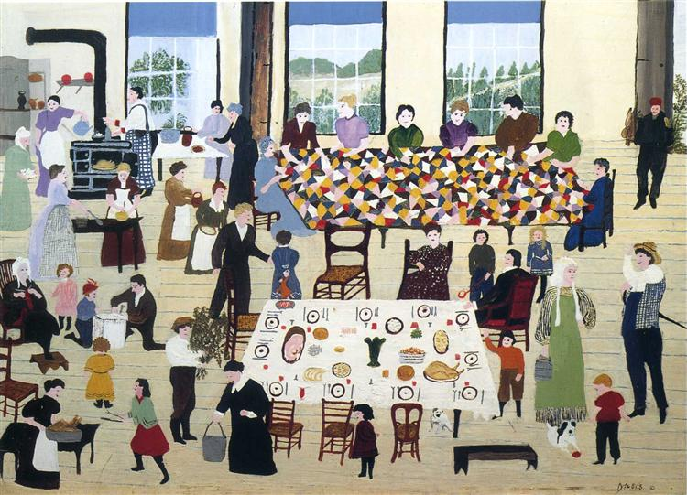
Artful Thinking
10 x 2 Routine
Look at the image quietly.
Let your eyes wander.
List 10 words or phrases about any aspect of the piece.
Repeat Steps 1&2: Look at this again and try to add 10 more words or phrases to your list.

Slide 3
Romeo and Juliet
Watch this balcony scene from Romeo and Juliet. Try to write down everything that happens with as much detail as possible.

Slide 4
Stage Directions
Stage Directions: an instruction in the text of a play, especially one indicating the movement, position, or tone of an actor, or the sound effects and lighting.
Review your list…Which items could be considered stage directions?

Slide 5
Following Directions
Let’s perform the play titled, Composition, written by Maureen Kane Berg
We are going to try to follow some stage directions written in a script while performing.

Slide 6
What Happened?
Look at your equations and write the steps for it.
Write your final work on paper to be displayed in the classroom.
Your poster should include the explanation and the steps of how it was solved.

Slide 7
Main Activity
You will use what you have learned to create your own multi-step problem with stage directions.
You may choose the way you present your problem.
Examples: performing your problem, reading it aloud, creating a video or computer animation

Slide 8
Closure
Write down 3 quiz questions using what you learned in this lesson.

Slide 9
HOW DID YOU DO?
THEATRE
MATH
✓
Did you explain each step in solving an equation and construct an argument to justify a solution method?
Did you practice and revise a scripted theatre work using theatrical staging directions?
Think about this lesson. Write 1-2 paragraphs about what you learned and each
of these questions.
✓

