Slide 1
Evaluating Design Solutions
THEATRE
SCIENCE
You will evaluate and justify the creation of theatrical design based on the creative process of the designer. You will also create an alternate original solution to a design challenge.
Artful Thinking
The Design Process
Scenic Designer
Wicked Set Design
Main Activity
How did you do?
Words you
will be using
design
process
space

Slide 2
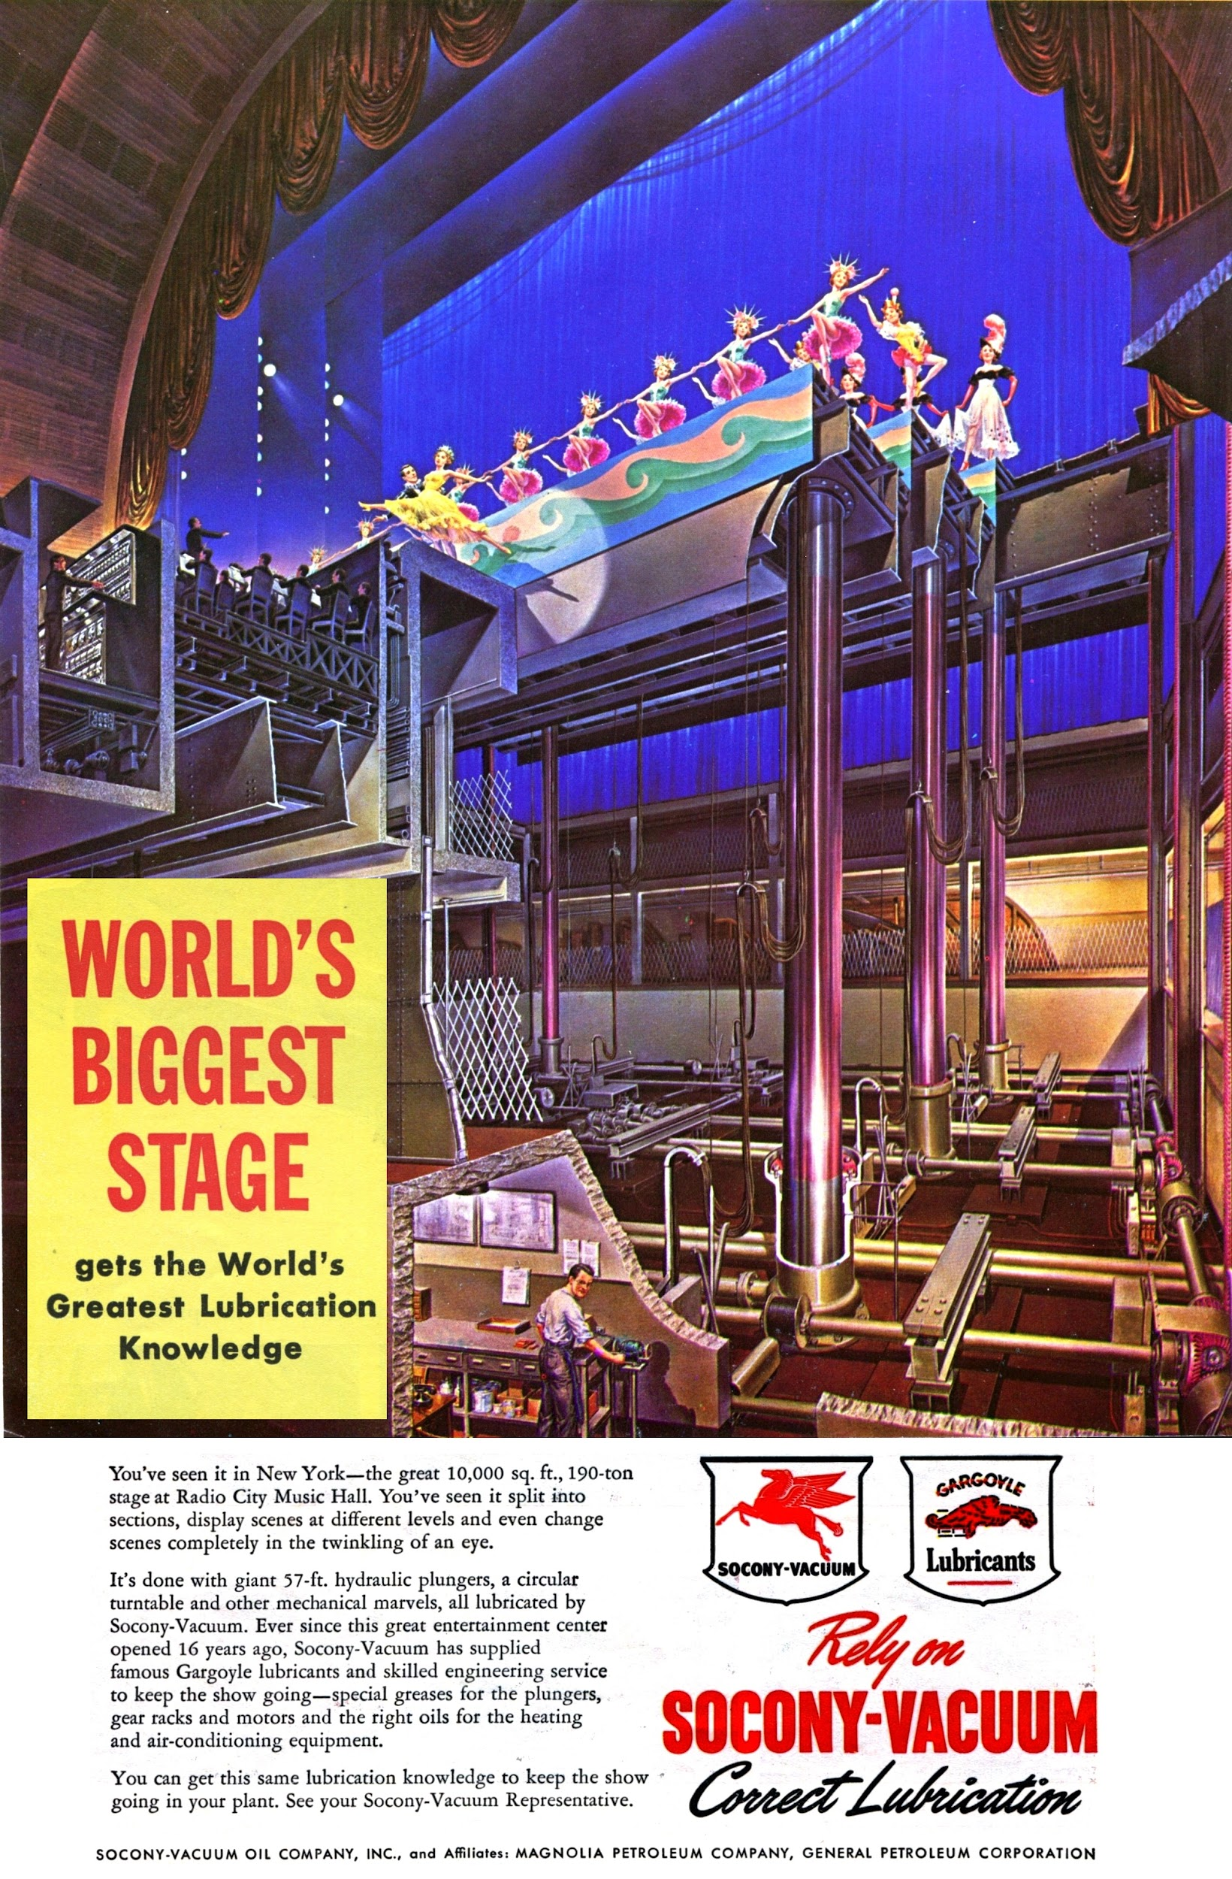
Artful Thinking
Parts / Purposes / Complexities Routine
What are its parts? (What are its pieces, components?)
What are its purposes? (What is it for, what does it do?)
What are its complexities? (How is it complicated in its parts, purposes, the relationship between the two, or other ways?)

Slide 3
The Design Process
Engineers and designers of all kinds create and revise multiple times during their work. They do this as they solve problems.
When is a time that you have been able to revise your work?

Slide 4
Scenic Designer

Slide 5
Wicked Set Design

Slide 6
Main Activity
You will consider an alternate way to have solved the designer’s task and to solve the challenge.
You will should be able to justify your choices and maintain the concept of the production.
You may choose any presentation model for your solution. What will best present your idea?
The more visual, the better!

Slide 7
How did you do?
THEATRE
SCIENCE
✓
Did you design a solution to a complex real-world problem by breaking it down into smaller problems that can be solved through engineering?
Did you explain and justify the selection of technical elements used to build a design that communicates the concept of a drama/theatre production?
Think about this lesson. Write 1-2 paragraphs about what you learned and each
of these questions.
✓

